Slide 1
Applied Physics NS (101)
LECTURE # 2
DATE: 22ND SEPTEMBER , 2020

Slide 2
Vectors
Vectors and their components
Unit Vector , adding vector by components
Multiplying Vectors

Slide 3
VECTORS AND THEIR COMPONENTS Objectives:
Add vectors by drawing them in head-to-tail arrangements, applying the commutative and associative laws.
Subtract a vector from a second one.
Calculate the components of a vector on a given coordinate system, showing them in a drawing.
Given the components of a vector, draw the vector and determine its magnitude and orientation

Slide 4


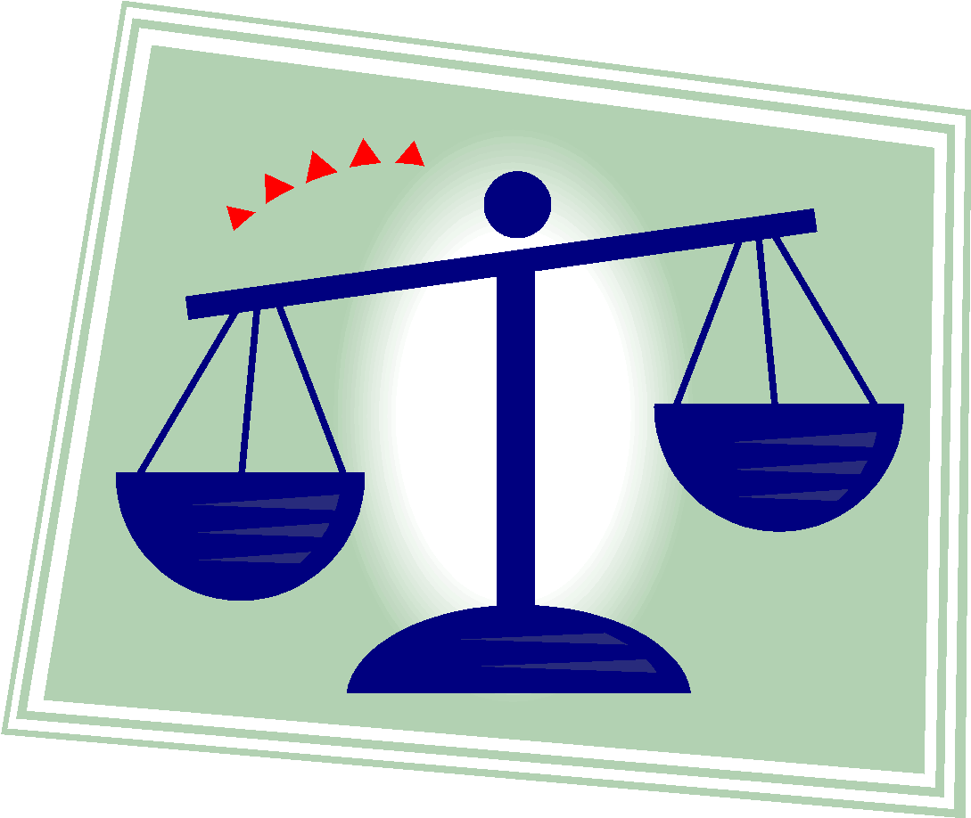
Scalars
Not all physical quantities involve a direction. Temperature, pressure, energy, mass, and time, for example, do not “point” in the spatial sense. We call such quantities scalars, and we deal with them by the rules of ordinary algebra. A single value, with a sign (as in a temperature of 40°F), specifies a scalar
Examples of Scalar Quantities:
Length
Area
Volume
Time
Mass

Slide 5
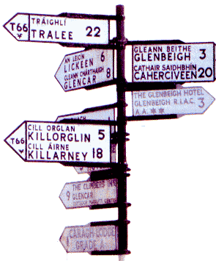
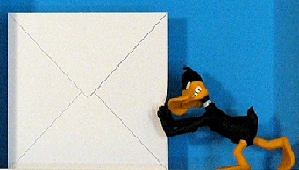
Vectors
A vector has magnitude as well as direction, and vectors follow certain
(vector) rules of combination, which we examine in this chapter. A vector
quantity is a quantity that has both a magnitude and a direction and thus can be represented with a vector.
Examples of Vector Quantities:
Displacement
Velocity
Acceleration
Force

Slide 6
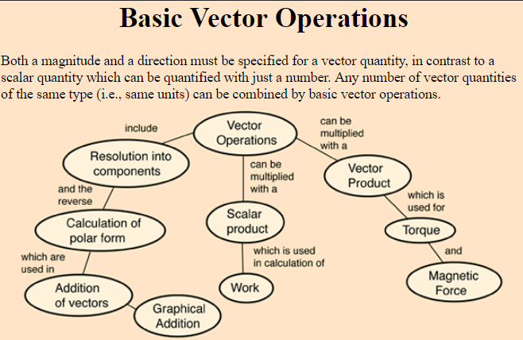

Slide 7
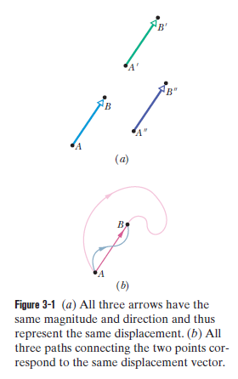

Vectors
The simplest vector quantity is displacement, or change of position. A vector that represents a displacement is called, reasonably, a displacement vector.

Slide 8
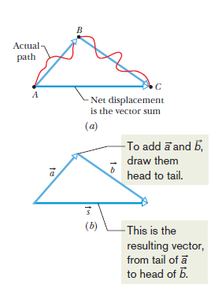

Adding Vectors Geometrically
Suppose that, as in the vector diagram of Fig. 3-2a, a particle moves from A to B and then later from B to C.We can represent its overall displacement (no matter what its actual path) with two successive displacement vectors, AB and BC.
The net displacement of these two displacements is a single displacement from A to C.We call AC the vector sum (or resultant) of the vectors AB and BC. This sum is not the usual algebraic sum.
We can represent the relation among the three vectors in Fig. 3-2b with the
vector equation

Slide 9
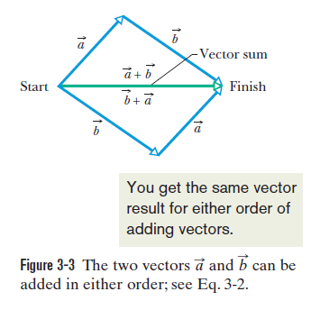

Properties of Vector Addition
Vector addition, defined in this way, has two important properties.
1. Commutative Law
2. Associative Law

Slide 10

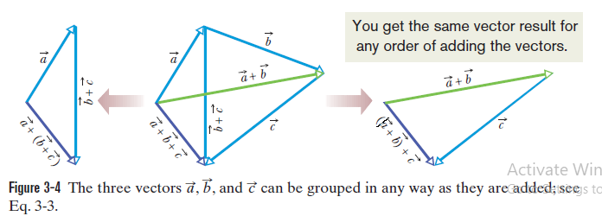
Properties of Vector Addition

Slide 11
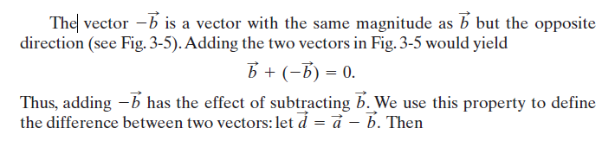

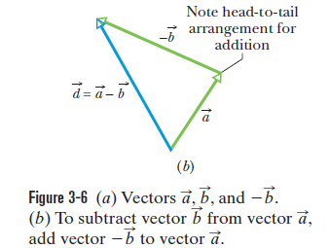
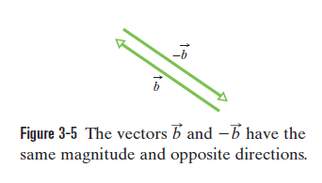
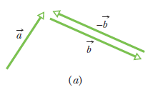
Vector Subtraction

Slide 12
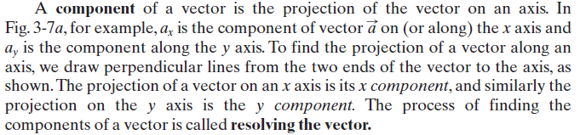
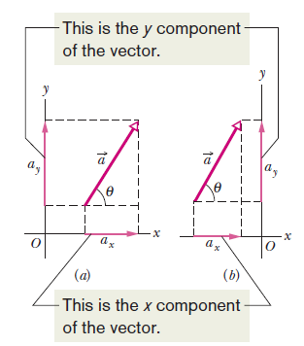

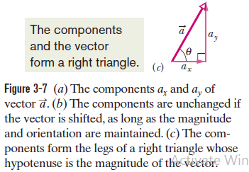
Components of Vectors

Slide 13
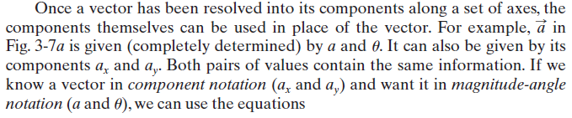
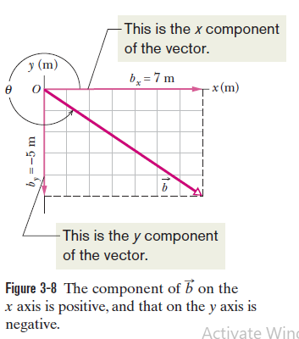

Components of Vectors

Slide 14

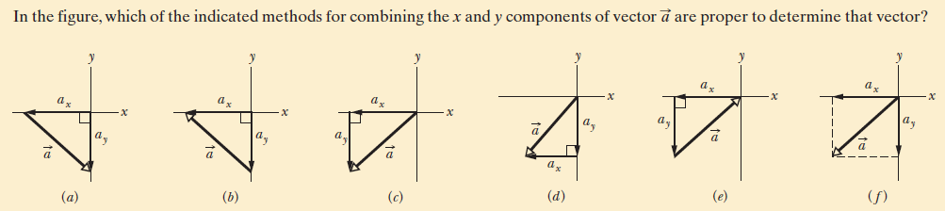
Check points

Slide 15
Unit Vector , Adding vector by components
Objectives:
Convert a vector between magnitude-angle and unit vector Notations.
Add and subtract vectors in magnitude-angle notation and in unit-vector notation.
Identify that, for a given vector, rotating the coordinate system about the origin can change the vector’s components
but not the vector itself.

Slide 16
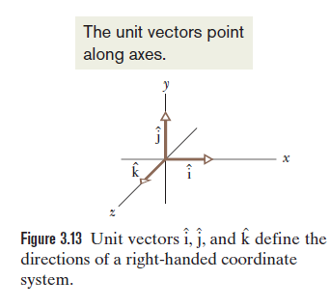
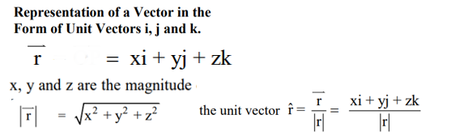
Unit Vector
A unit vector is a vector that has a magnitude of exactly 1 and points in a particular
direction. It lacks both dimension and unit. Its sole purpose is to point—that
is, to specify a direction.
The unit vectors in the positive directions of the x, y, and z axes are labeled , , and , where the hat is used instead of an overhead arrow as for other vectors (Fig. 3-13).The arrangement of axes in Fig. 3-13 is said to be a right-handed coordinate system.

Slide 17

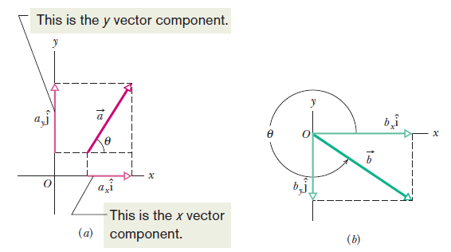
Unit Vector
The quantities ax and ay are vectors,
called the vector components of .The quantities ax and ay are scalars, called
the scalar components of :a (or, as before, simply its components).

Slide 18
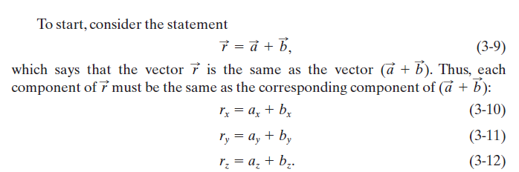

ADDING VECTORS BY COMPONENTS
We can add vectors geometrically on a sketch or directly on a vector-capable
calculator. A third way is to combine their components axis by axis.
To subtract, we add (a ) and (–b) by components, to

Slide 19
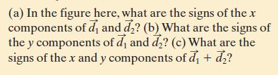
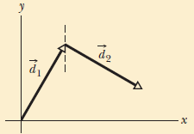
Check points

Slide 20
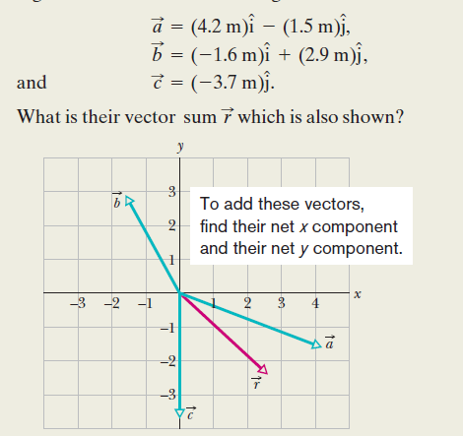



Example

Slide 21
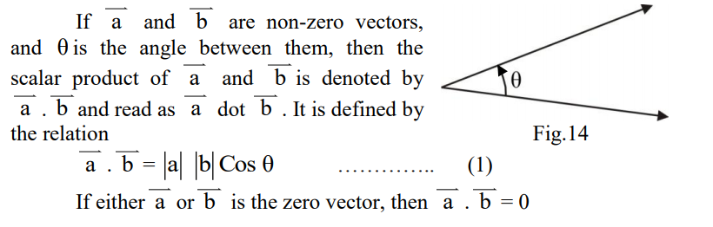
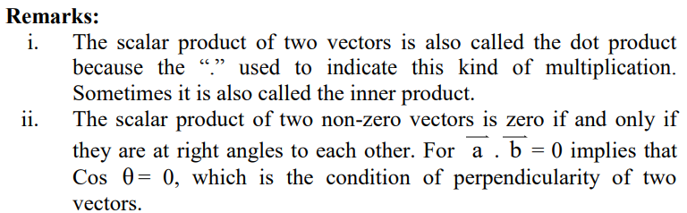
MULTIPLYING VECTORS

Slide 22
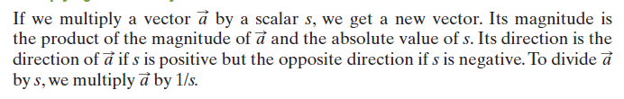

MULTIPLYING VECTORS
There are three ways in which vectors can be multiplied, but none is exactly like
the usual algebraic multiplication.
Multiplying a Vector by a Scalar
Multiplying a Vector by a Vector

Slide 23
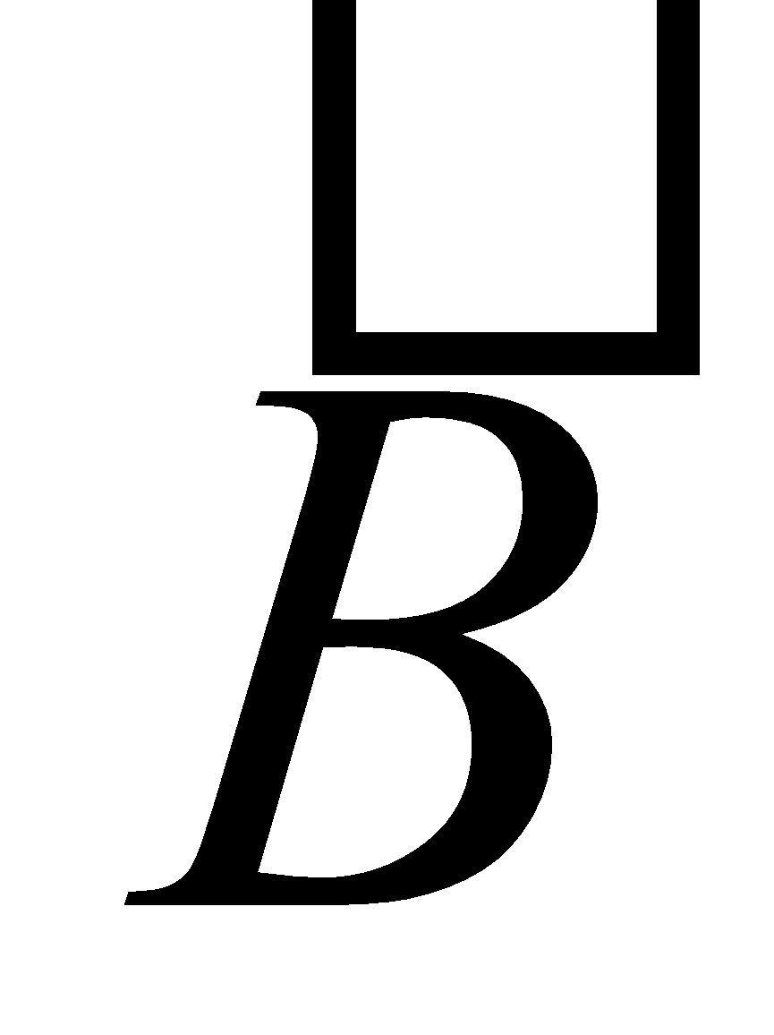
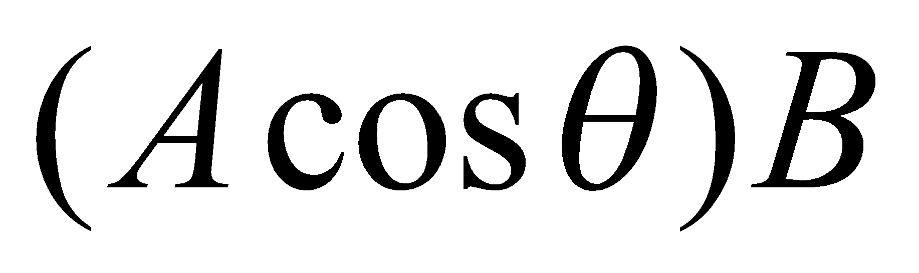
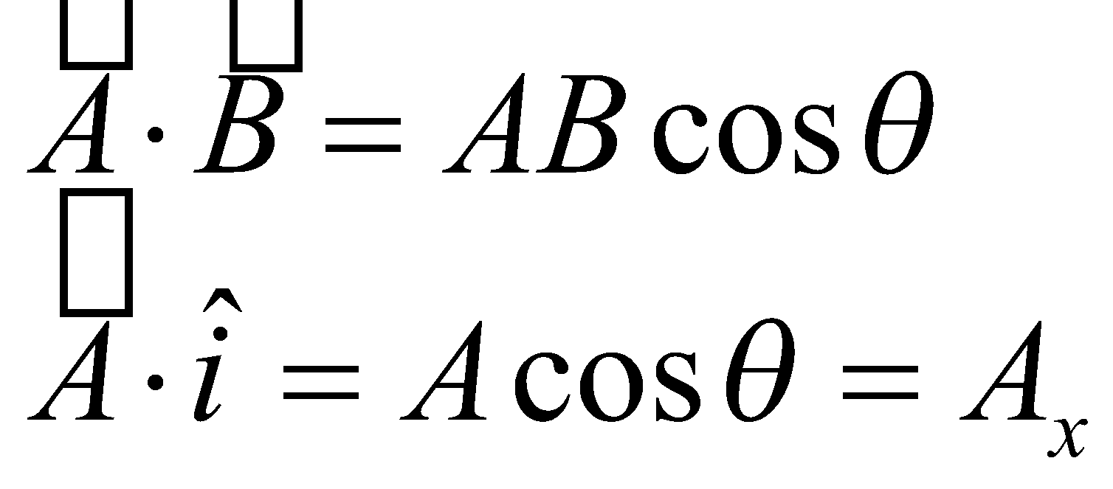
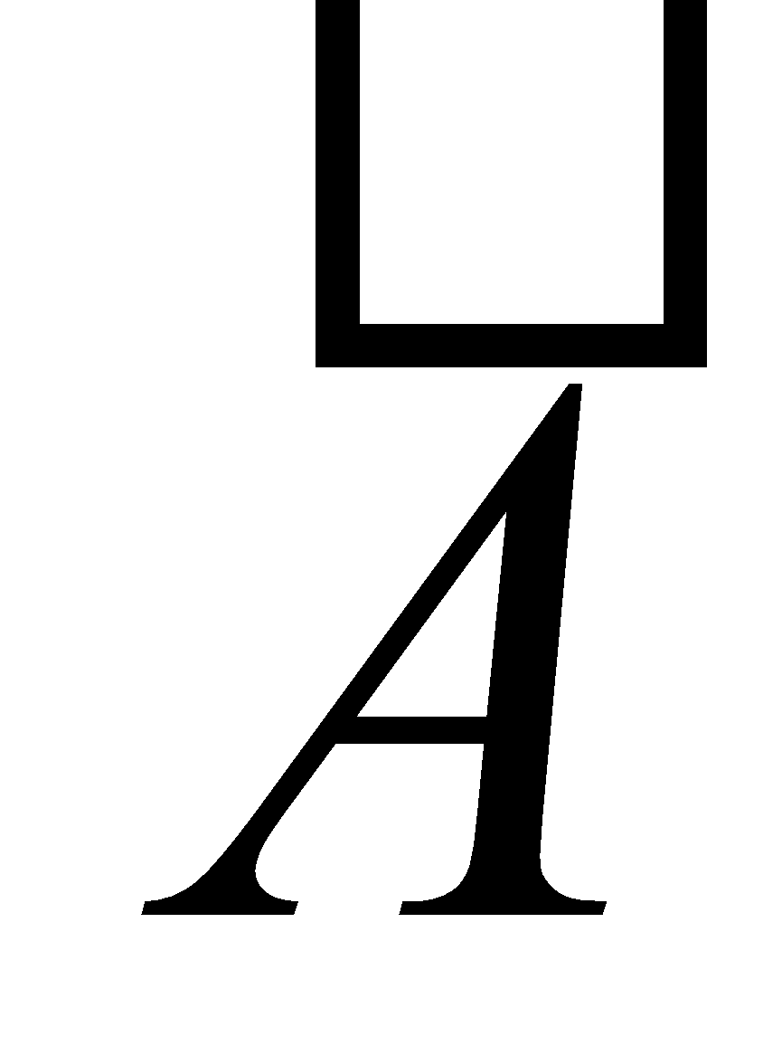
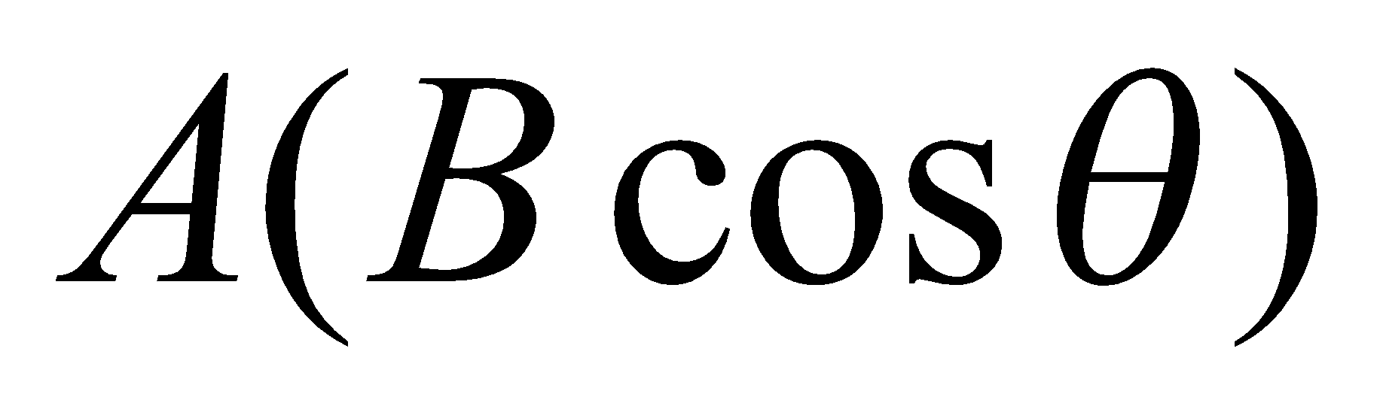
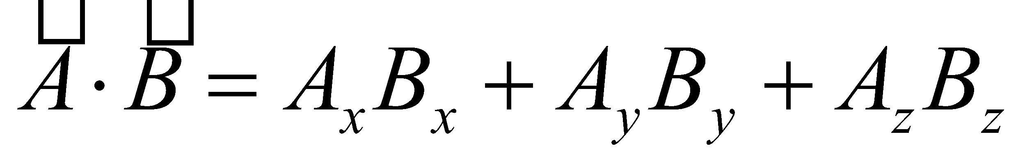
Dot Product
The dot product says something about how parallel two vectors are.
The dot product (scalar product) of two vectors can be thought of as the projection of one onto the direction of the other.
Components
θ

Slide 24
Projection of a Vector: Dot Product
The dot product says something about how parallel two vectors are.
The dot product (scalar product) of two vectors can be thought of as the projection of one onto the direction of the other.
Components
Projection is zero
π/2

Slide 25
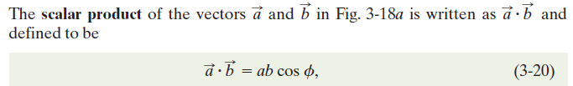
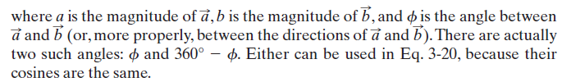
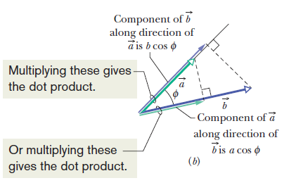
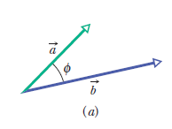
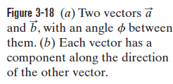
The Scalar Product

Slide 26
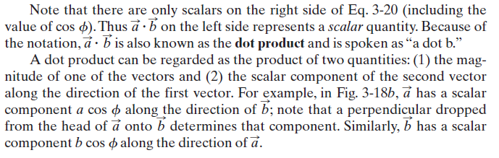



The Scalar Product

Slide 27
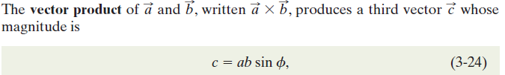
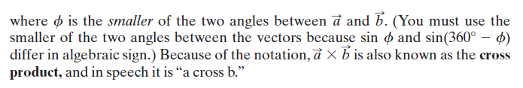
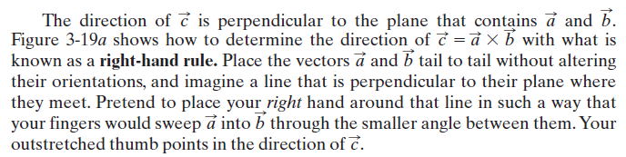

The Vector Product

Slide 28
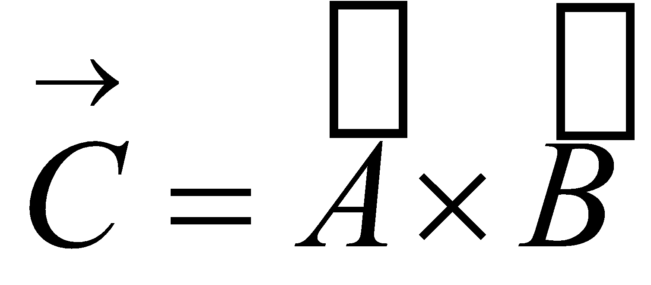
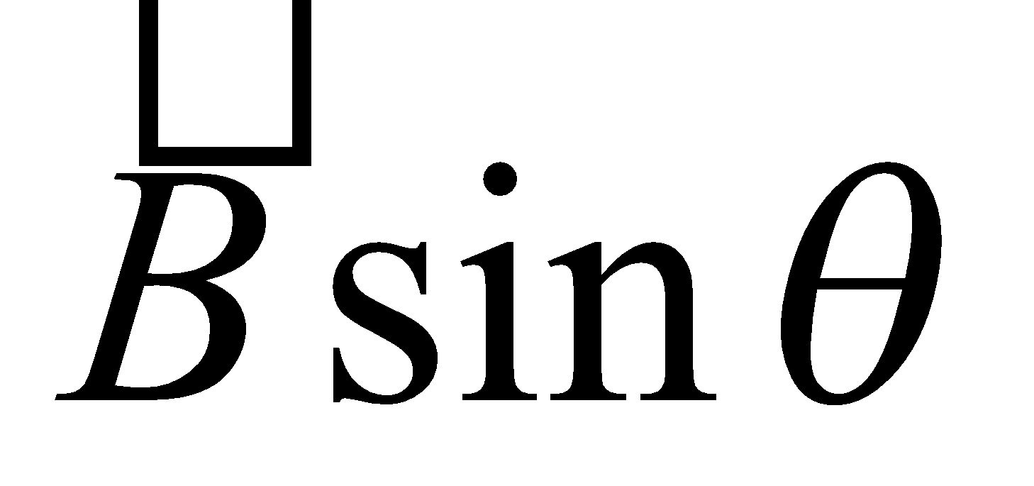
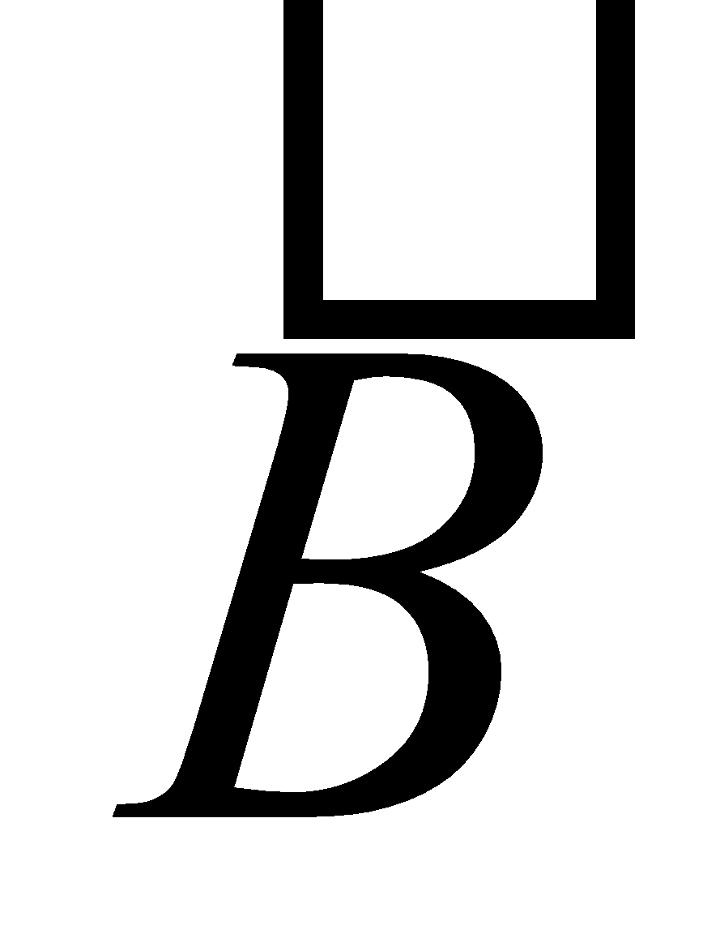
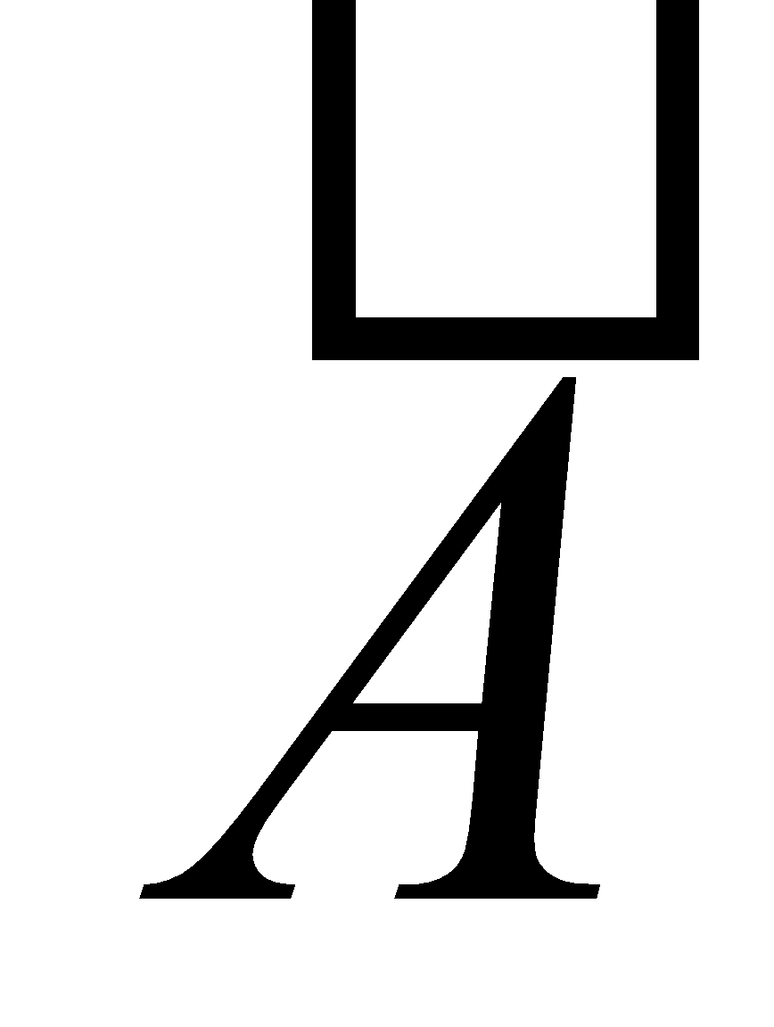
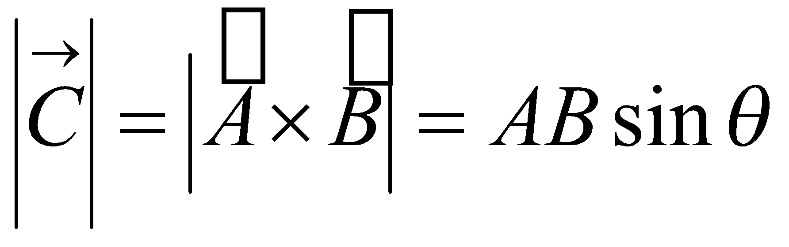
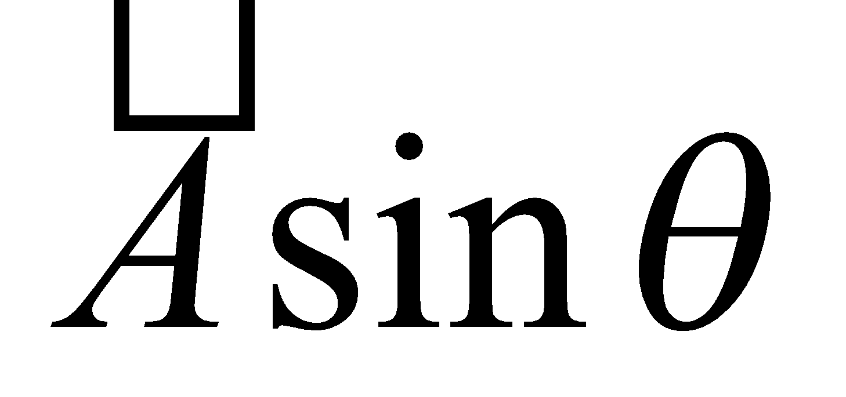
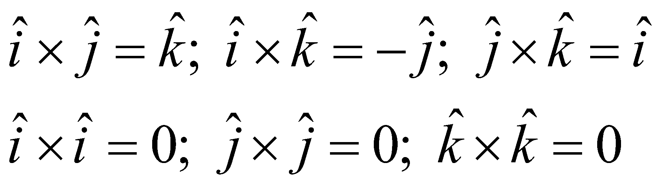
Vector Product
The cross product of two vectors says something about how perpendicular they are.
Magnitude:
θ is smaller angle between the vectors
Cross product of any parallel vectors = zero
Cross product is maximum for perpendicular vectors
Cross products of Cartesian unit vectors:
θ
y
j
i
x
k
z
i
j
k

Slide 29





Vector Product
Direction: C perpendicular to both A and B (right-hand rule)
Place A and B tail to tail
Right hand, not left hand
Four fingers are pointed along the first vector A
“sweep” from first vector A into second vector B through the smaller angle between them
Your outstretched thumb points the direction

Slide 30



Vector Product
The quantity ABsinθ is the area of the parallelogram formed by A and B
The direction of C is perpendicular to the plane formed by A and B
Cross product is not commutative
The distributive law
The derivative of cross product
obeys the chain rule
Calculate cross product

Slide 31




Slide 32



Slide 33


Commutative property

Slide 34


Check points

Slide 35

Example: Finding the Components of an Acceleration Vector

Slide 36

Example: Finding the Components of an Acceleration Vector

Slide 37


Example Finding the Direction of Motion

Slide 38


Example Finding the Direction of Motion

Slide 39



Example 3.5 Run Rabbit Run!

Slide 40




Examples

Slide 41








